Slide 1
Border States: “Driving Transformation, Innovation, and AI with SAP BTP”
- 2024 BTP Executive Summit - Chicago

Slide 2

Alex Burkel
Software Engineering Manager

Slide 3
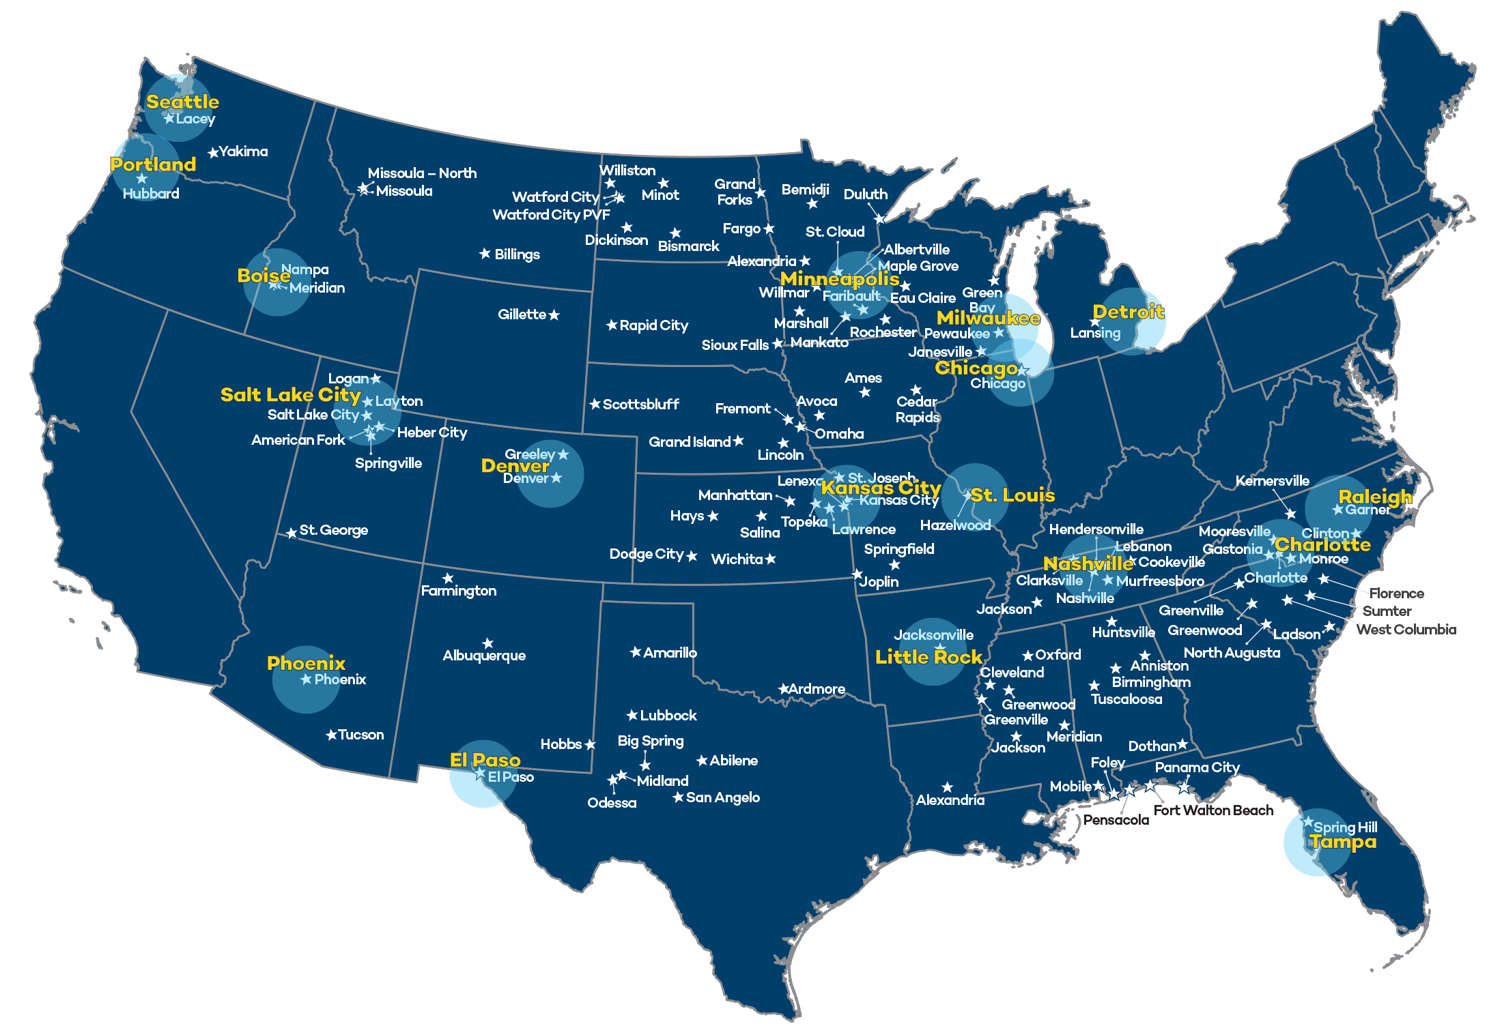
Who is Border States?
HQ
A 100% Employee-Owned Wholesale Distributor servicing the Construction, Industrial, and Utility Markets
Based out of Fargo, ND

Slide 4
Challenges of Integration Gaps
Operational Inefficiencies
Manual Data Entry
Delayed Order Processing
Inventory Management Issues
Vendor Relationship Strain
Inconsistent order fulfillment
More frequent discrepancies, leading to delays
Customer Service Challenges
Inaccurate Information Sharing
Longer Response Times
Decreased Customer Satisfaction
“Direct data integration with vendors is becoming an important factor in Vendor/Distributor relationships.”
"The lack of integrations between customer and vendor systems amplifies operational inefficiencies, causing manual workarounds, and frequent errors. This disconnect can erode trust, and ultimately impact customer satisfaction and vendor relationships."
**Paraphrased from internal IT conversations

Slide 5
Challenges of Integration Gaps
“Direct data integration with vendors is becoming an important factor in Vendor/Distributor relationships.”
"The lack of integrations between customer and vendor systems amplifies operational inefficiencies, causing manual workarounds, and frequent errors. This disconnect can erode trust, and ultimately impact customer satisfaction and vendor relationships."
**Paraphrased from internal IT conversations
Operational Inefficiencies
Vendor Relationship Strain
Customer Service Challenges
Manual Data Entry
Delayed Order Processing
Inventory Management Issues
Inconsistent order fulfillment
More frequent discrepancies, leading to delays
Inaccurate Information Sharing
Longer Response Times
Decreased Customer Satisfaction

Slide 6
Border States BTP Services Journey
Integration Suite (Cloud Integration)
Business Application Studio
SAP HANA Cloud - POC
SAP Alert Notification
Datasphere & AI
2017
2018
2019
2020
2021
2022
2023
2024
Mobile Services
API Management
Event Mesh - POC
MDK Apps

Slide 7
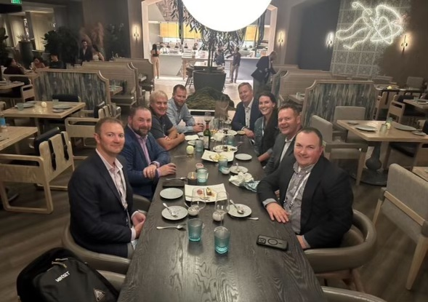

Why we chose Mindset
Deep expertise in SAP BTP
Continue to deliver excellent results
Strong relationship and trust
Committed to Innovation
Human-Centered Design approach

Slide 8
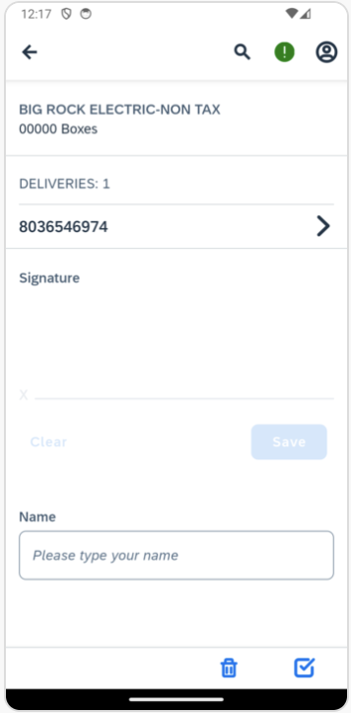
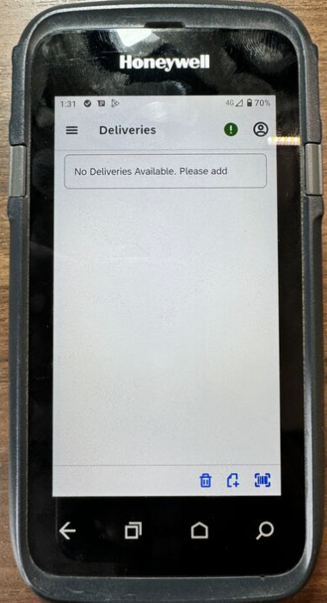


SAP Mobile Services
Engagement with Mindset to rebuild our existing signature capture applications.
  Shift from SAP SMP SDK to MDK
  (Mobile Development Kit)
  Migration from SAP Neo Environment to
  Cloud Foundry on Azure
  Modernized and improved user experience
  Native, cross-platform, and offline

Slide 9
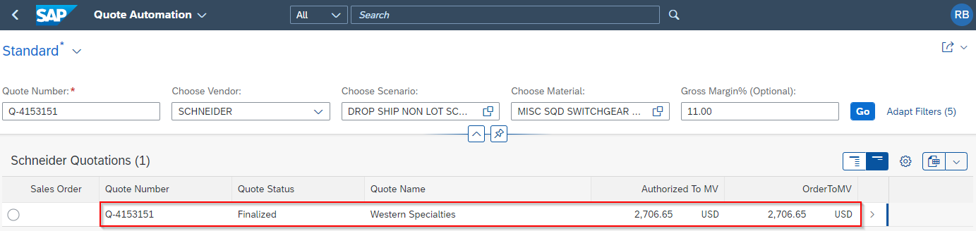


Quote Automation Tool

Slide 10
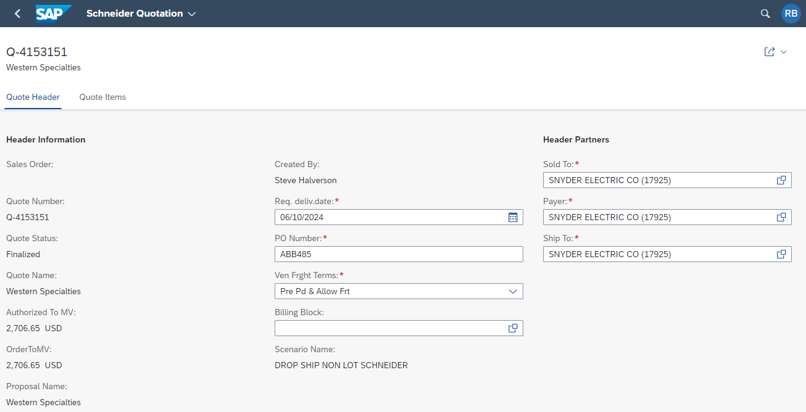
Quote Automation Tool
“Our new functionality in SAP has garnered some awesome comments, including “Wow!” “That is awesome”, “When is that ready to go” and “That is a gamechanger. This thing will save me so much time!”
Kent Fischer – Operations Special Projects Manager
Time Savings
100+ line-item orders
Prior Time: ~2 hours
New Time: ~2 minutes

Slide 11
Integration Center of Excellence
Addition of security policies
WAF (Web Application Firewall)
Defined naming conventions, enterprise standards, guidelines
Defined version controls
Backup and Recovery
Monitoring and alerting
Custom Domain Name

Slide 12
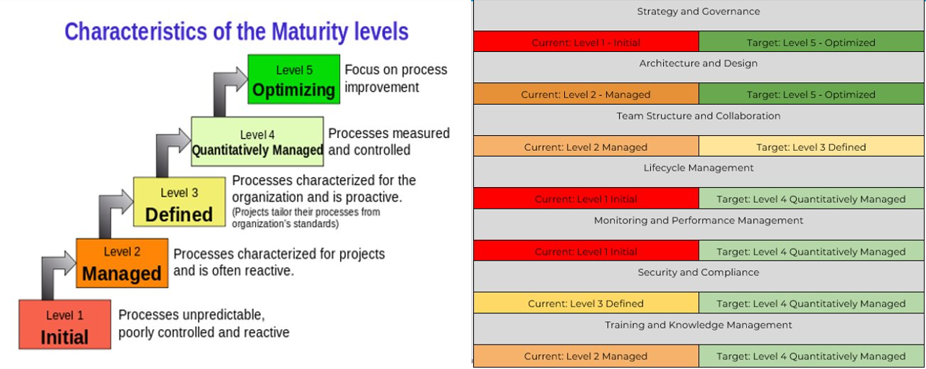
Integration Maturity Assessment

Slide 13
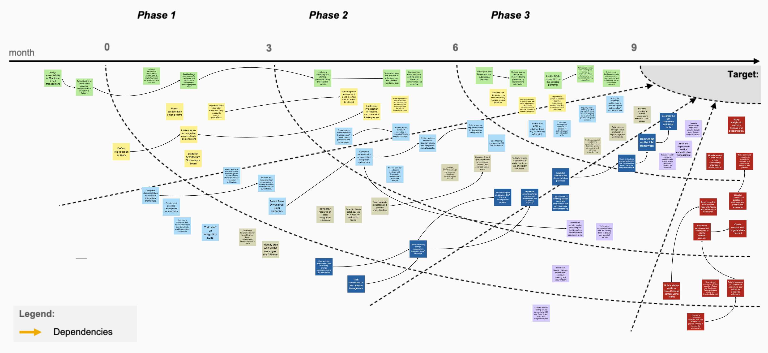
Integration Maturity Assessment

Slide 14
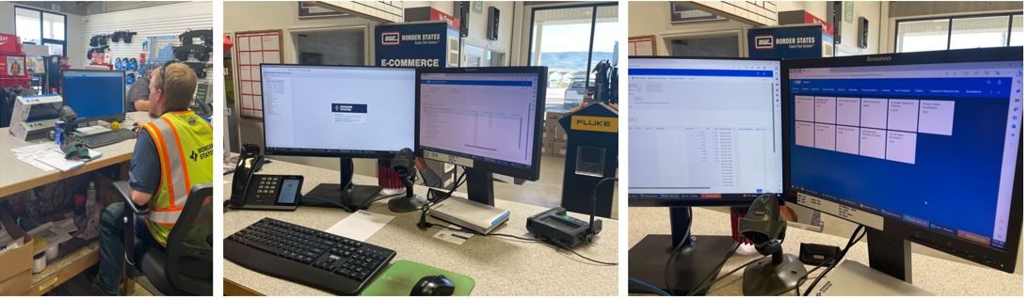
Site Visits: Customer Service at Border States

Slide 15
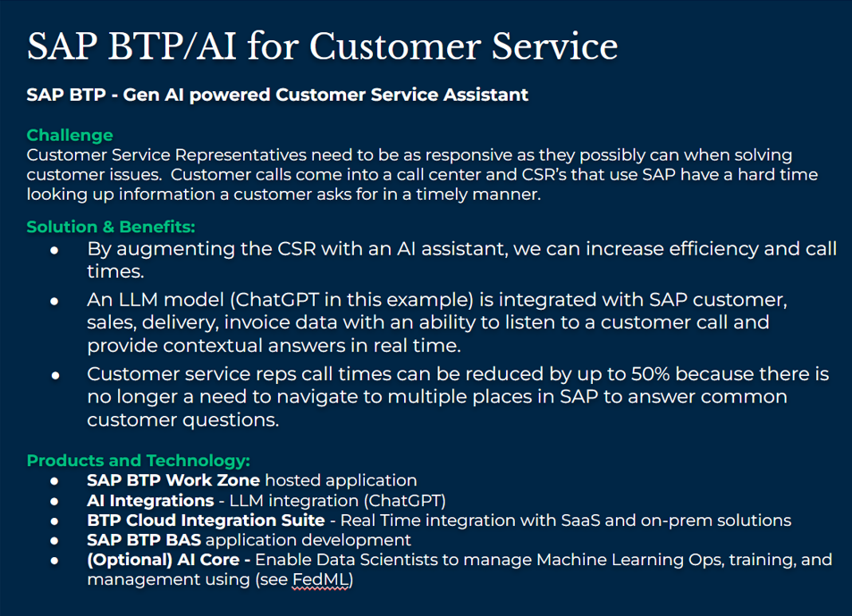
AI Assistant
Gain real-time visibility on the customers contextual information
Access customers information centrally without navigating to multiple places in SAP
Answer common inquiries in seconds and not minutes

Slide 16
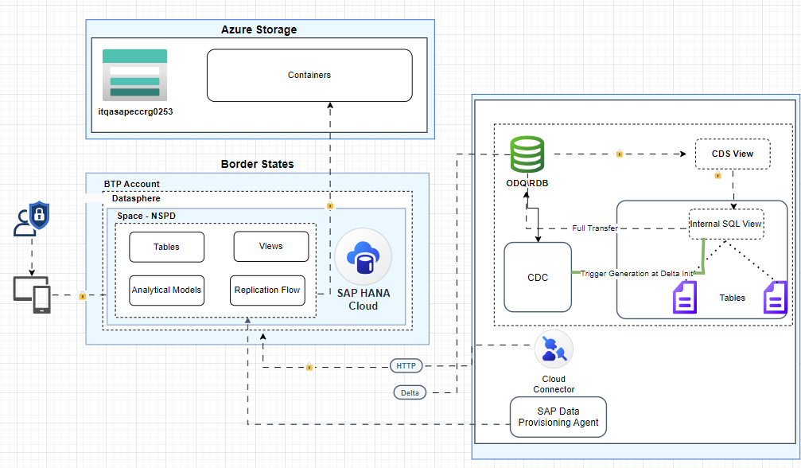
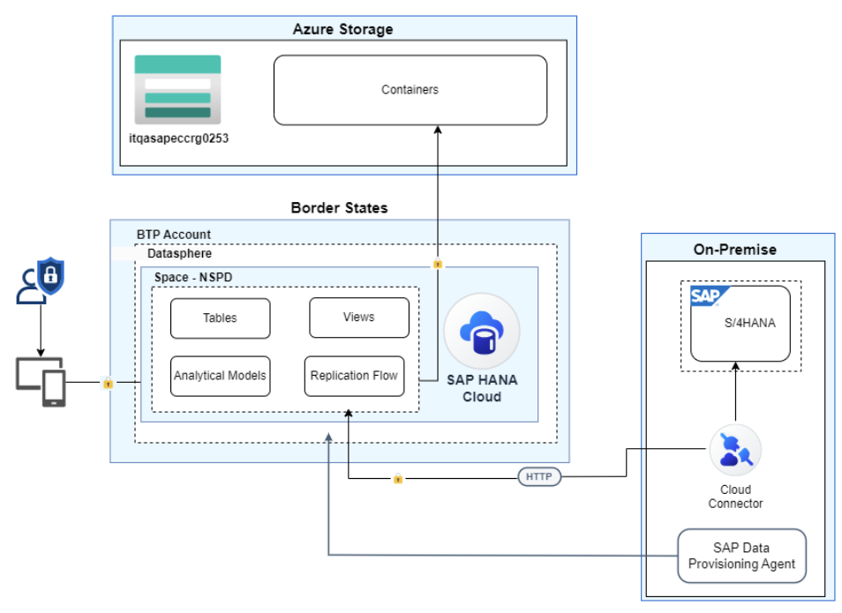
SAP Datasphere
Build data pipeline from on-premise S/4HANA system to Azure for consumption into Azure Synapse for analytics

Slide 17


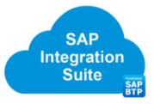
Centralized Integration Suite
PO (Process Orchestration) migration to SAP Cloud Integration
Apache Nifi migration to SAP Cloud Integration
Notes:
Accidental architecture = technical debt

Slide 18
Lessons Learned
Find a reliable partner to work with
Establish an Integration CoE sooner than later
Perform an integration assessment from a 3rd party
Minimize integration middleware's
Minimize technical debt
Continue pushing POC’s and innovation

Slide 19
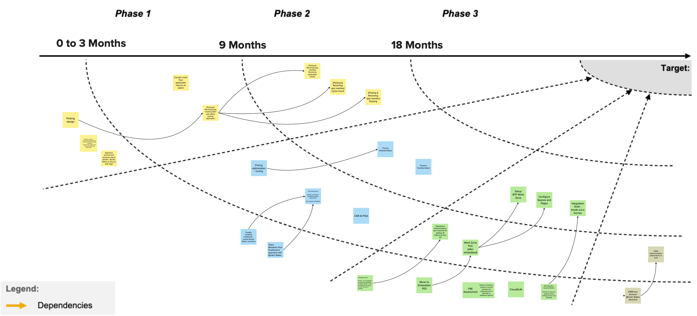
What’s Next? More BTP
Event Mesh
SAP Build Code
SAP Build Process Automation
SAP Build Work Zone
SAP AI Core
SAP AI Launchpad

